Slide 1
Fraud Detection
Ian and Samuel

Slide 2
Problem statement
Fraud detection is crucial for any lending and borrowing financial institutions.
This helps with the protection of client information and also with the credibility of the financial institution.
Fraud detection is a very important aspect of risk analysis and helps gauge the overall strength of an institution’s cyber security.

Slide 3
Exploratory Data Analysis
Described Data
Showcased maximum/minimum amount, Standard deviation, Mean, and Count
Showcased percentiles(75, 50, and 25)
Used various different categories to classify data
Checked if there are any null values in columns

Slide 4
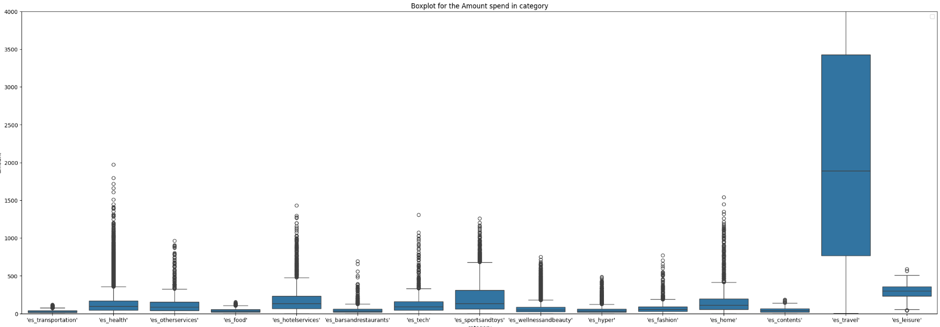
Data Pre Processing

Slide 5
Box plot illustration
The above diagram shows how each category in the dataset differs in the number of fraudulent and non fraudulent transactions.
As seen above the greatly affected category is travel and it is our outlier.
We shall have to drop this category so that it does not distort our results/findings.

Slide 6
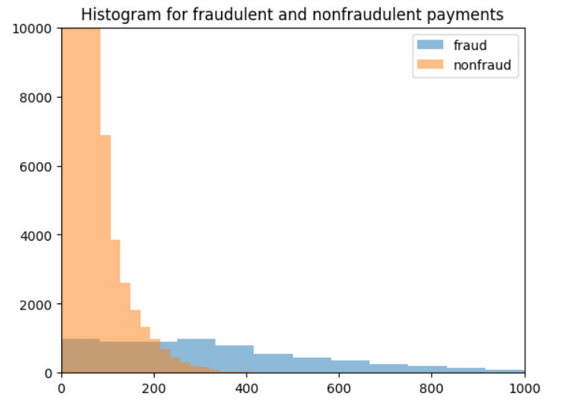
Illustration of a Histogram

Slide 7
Explanation of the histogram
The histogram diagram depicts that even though the non fraudulent transactions are more in occurrences the fraudulent transactions are more in amount.

Slide 8
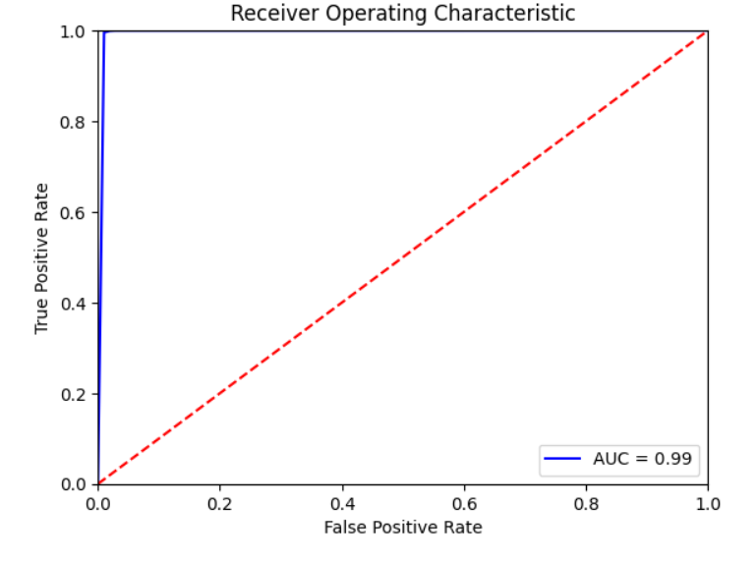
KNN Classifier

Slide 9
Explanation of the KNN classifier
This shows the ROC-AUC curve.
The accuracy level here is 0.99 hence this shows that our model will give us accurate and desired outcome.

Slide 10
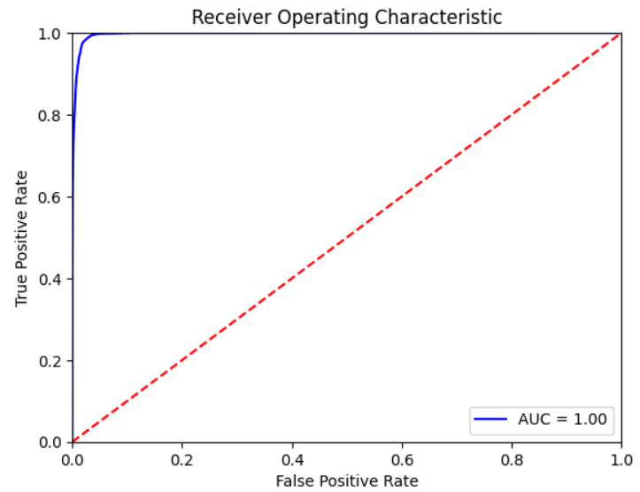
Random Forest Classifier

Slide 11
Illustration of Random Forest classifier
The accuracy level of this model is 1 which gives us confidence in our model giving us correct/desired outcomes.

